Slide 1
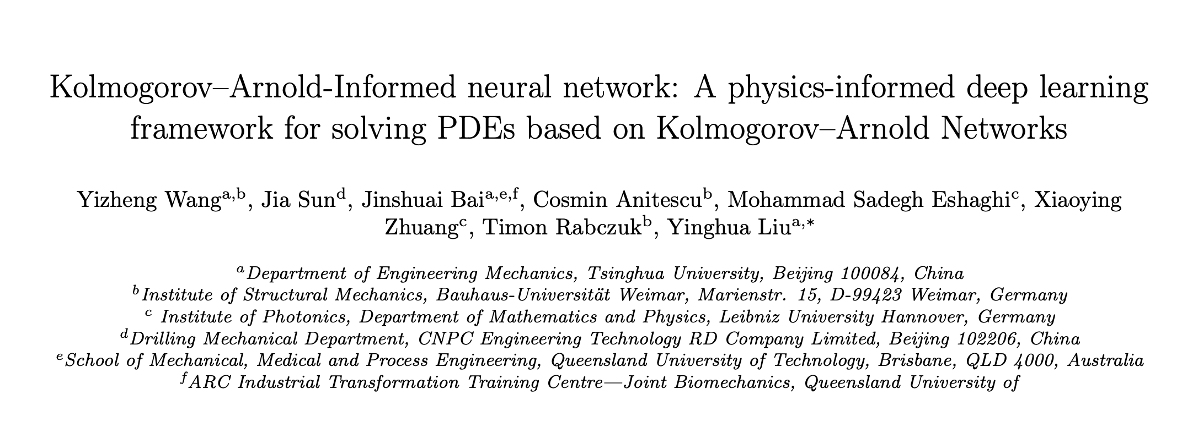

Slide 2
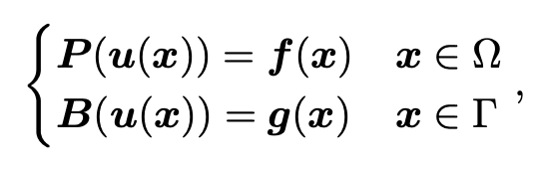
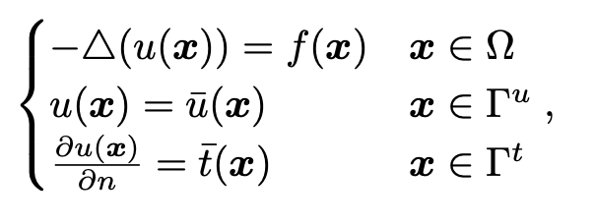
problem setting

Slide 3
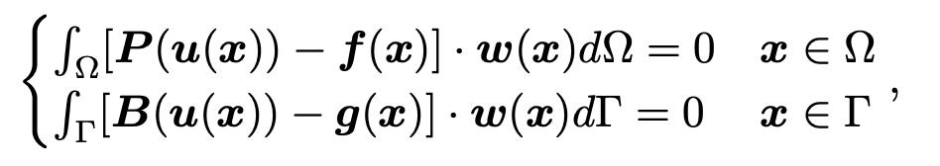
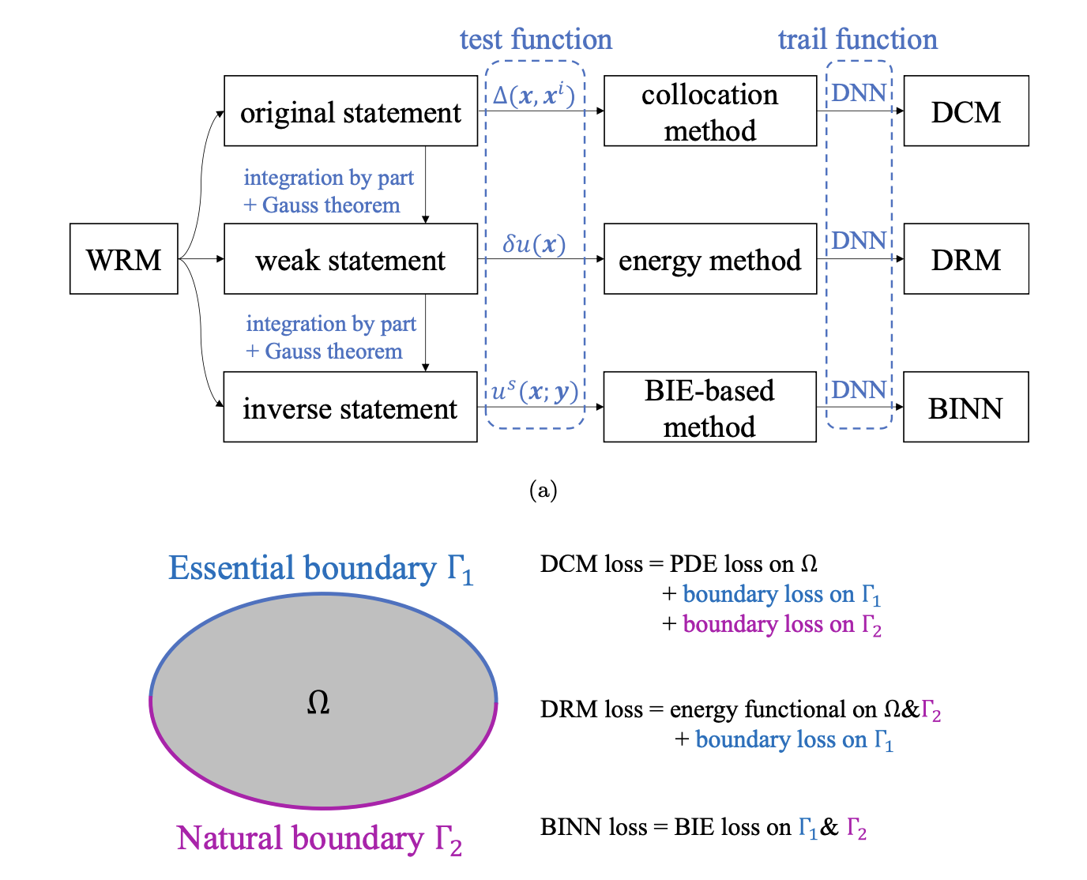
weighted residual form
Deep Collocation method
Deep Ritz method
boundary-integral

Slide 4
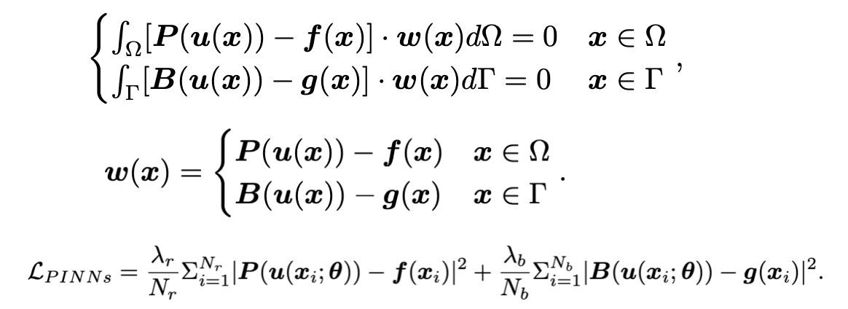
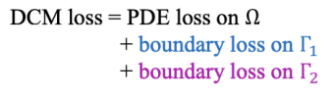
DCM

Slide 5
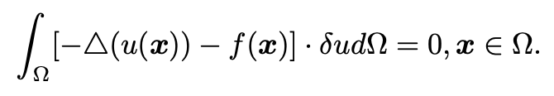
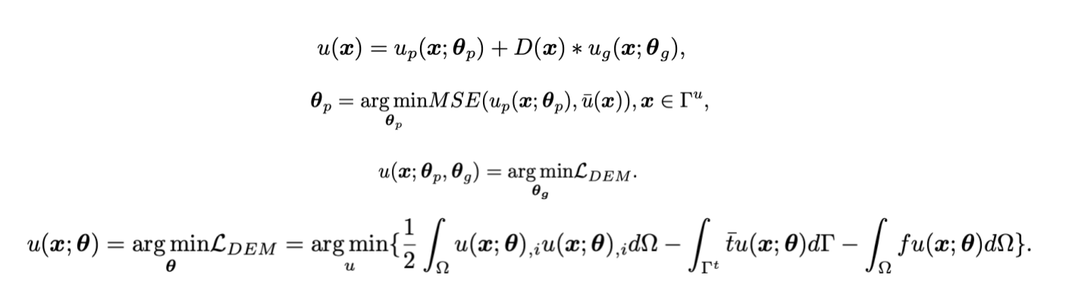
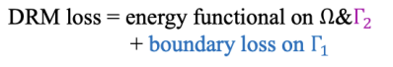
DRF

Slide 6
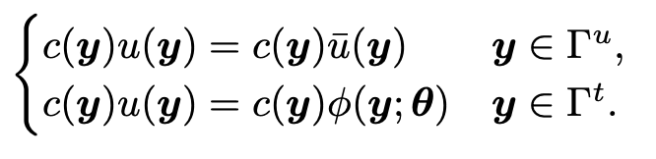
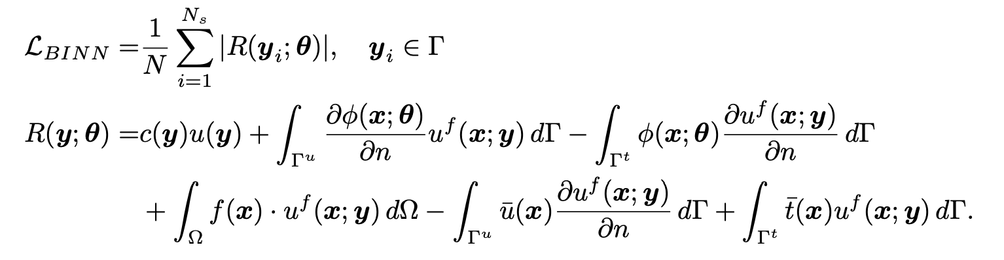
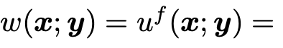
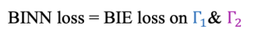
BINN
其中

Slide 7
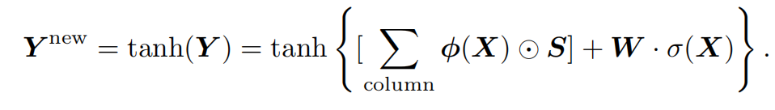
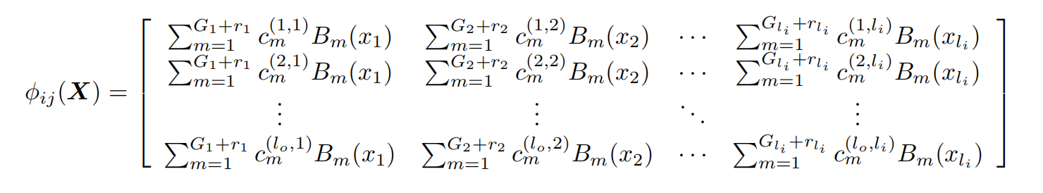
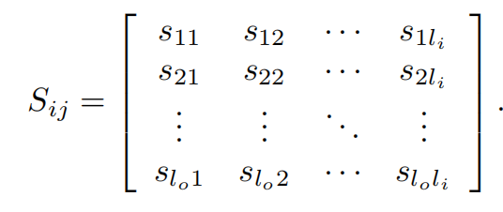
KAN

Slide 8
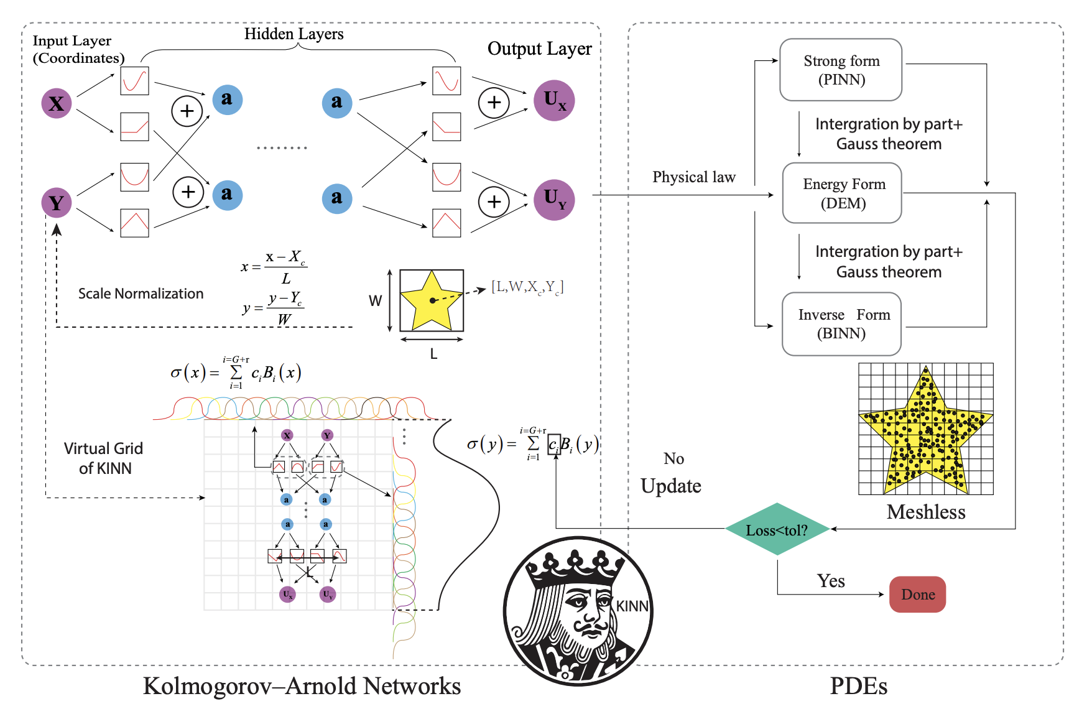
KINN

Slide 9
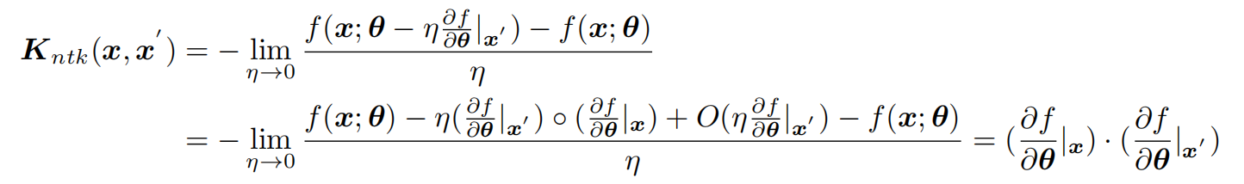
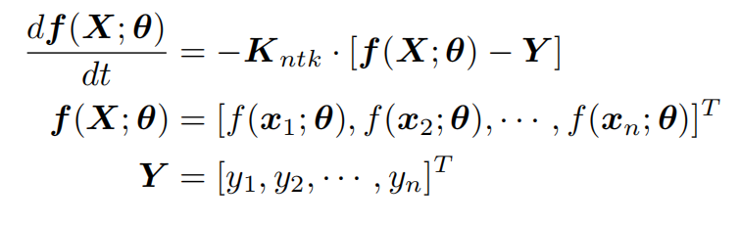
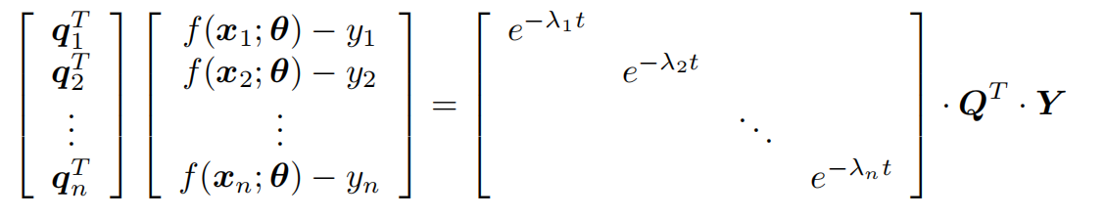
频谱偏差理论分析
可以看到在无限宽网络假设下（核函数不是时变函数），以特征值大小收敛的loss在采样点上是以ntk对应特征值的特
征向量的值为权重进行优化的，即当特征向量值较为均匀时，优化对采样点是无偏好的泛化性较好。而在MLP架构中
，大特征值（收敛最快的）对应的特征向量值几乎都为低频的，也就是先优化低频信号，此即频谱偏差。

Slide 10
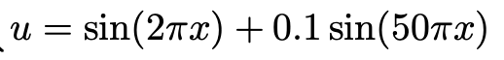
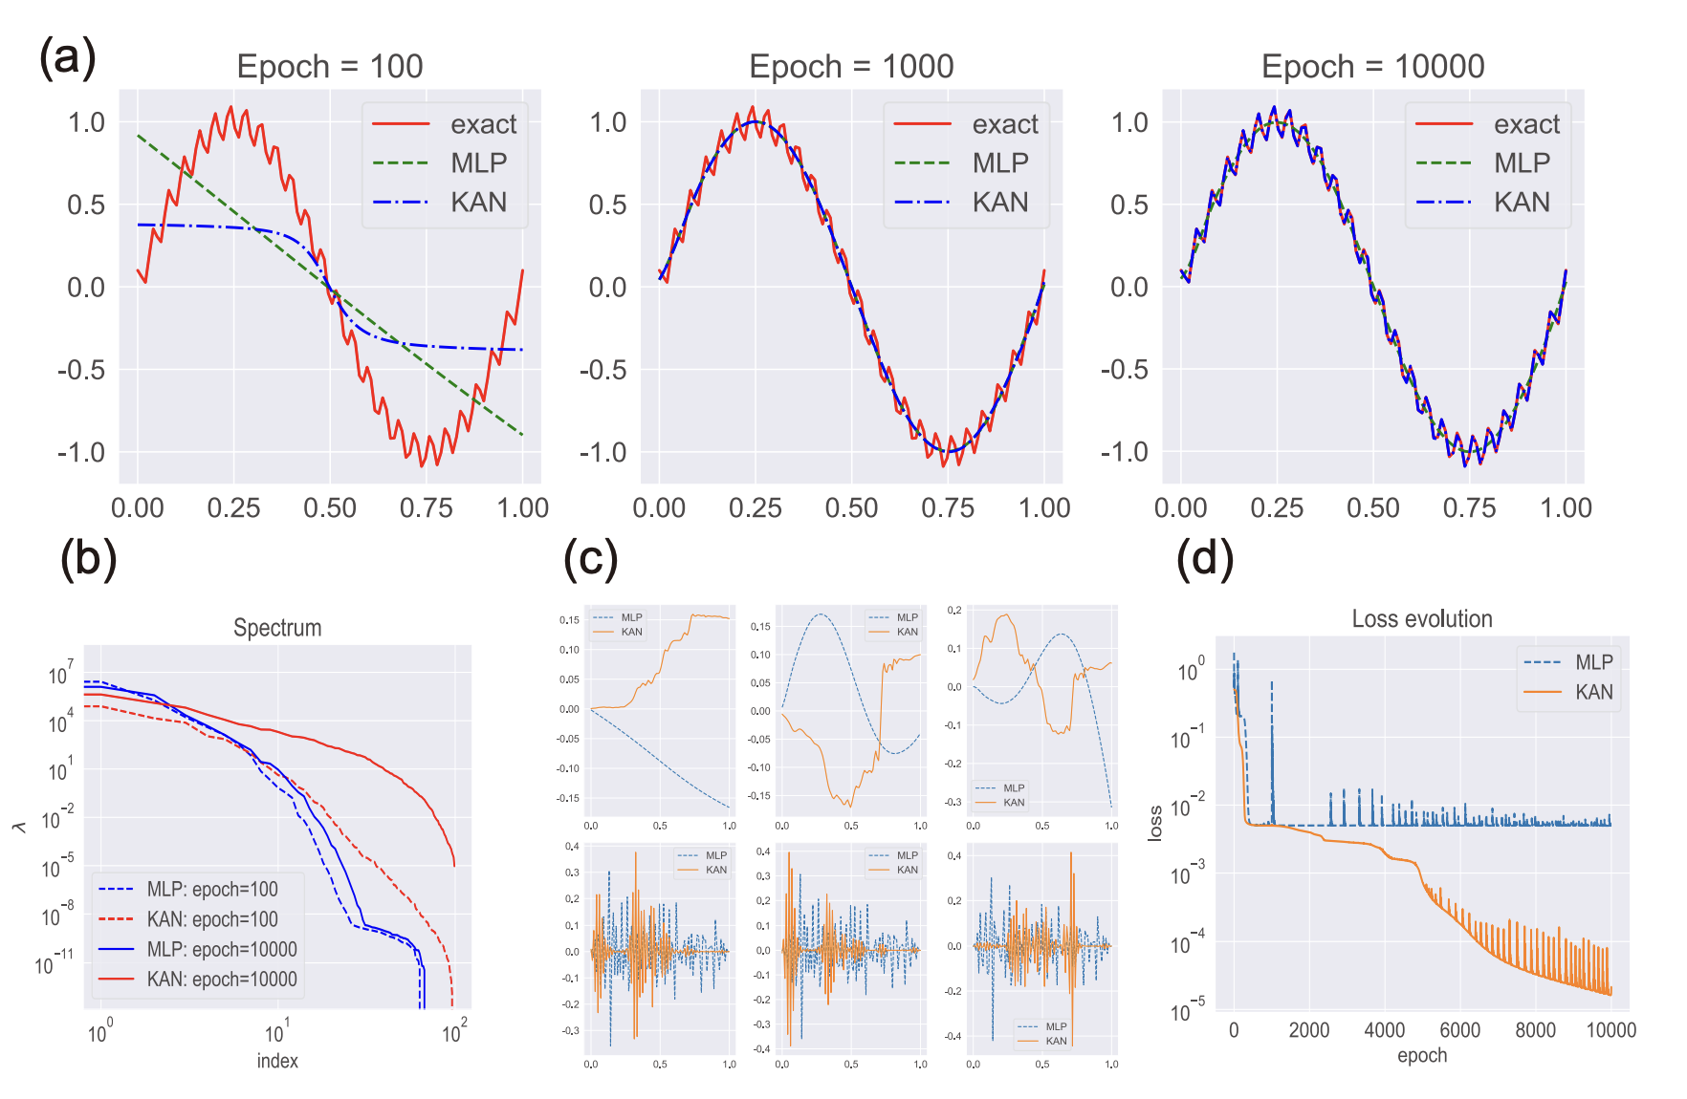
experiment
1. KAN的频谱偏差问题较小

Slide 11
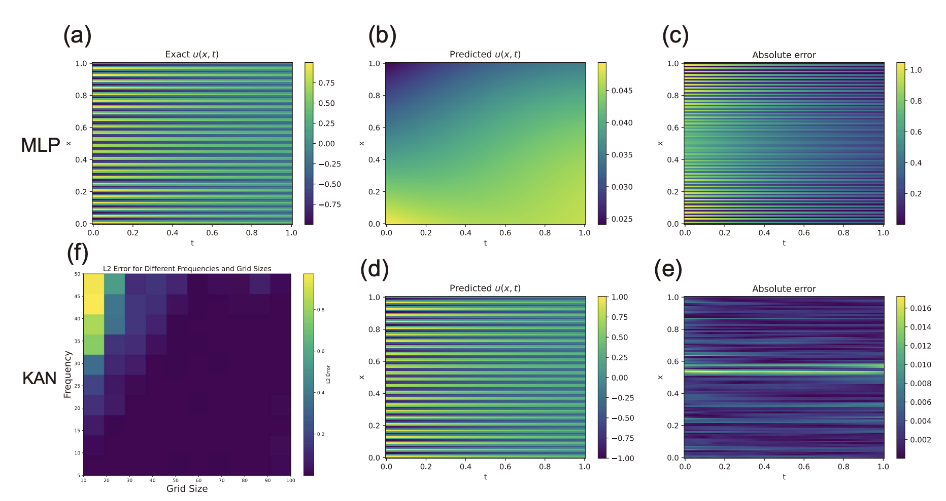
experiment
2. 混合频率热传导问题

Slide 12
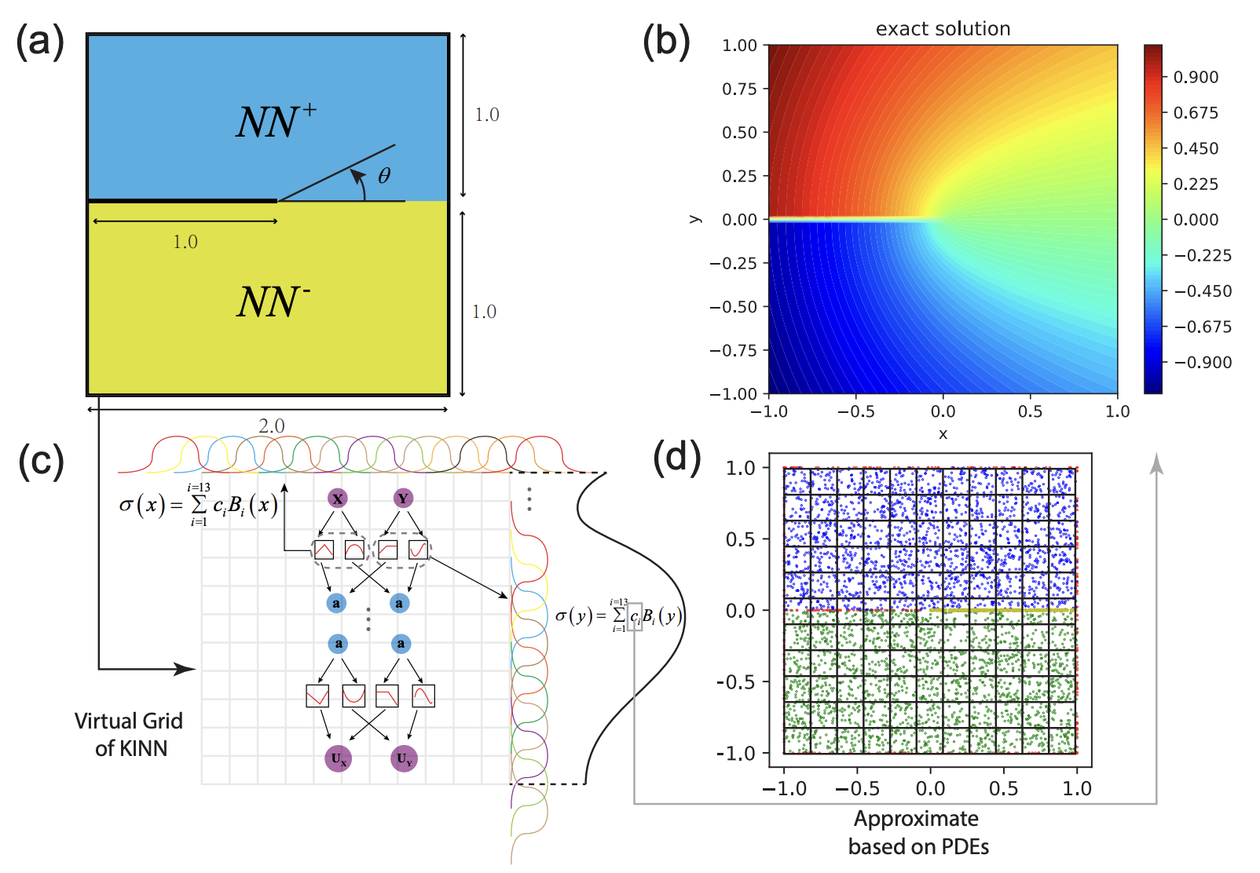
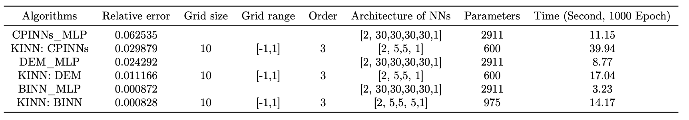
3. 三型断裂问题（具有奇点）

Slide 13
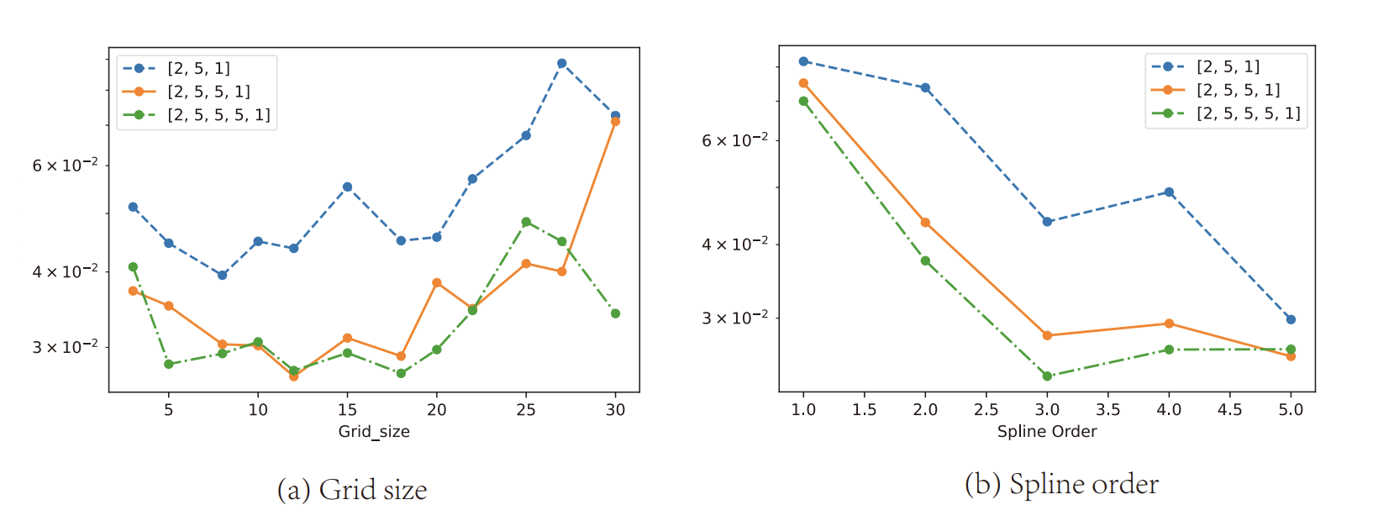
an overly large grid size can cause KAN to fail, i.e., the error increases due to overfitting.

Slide 14
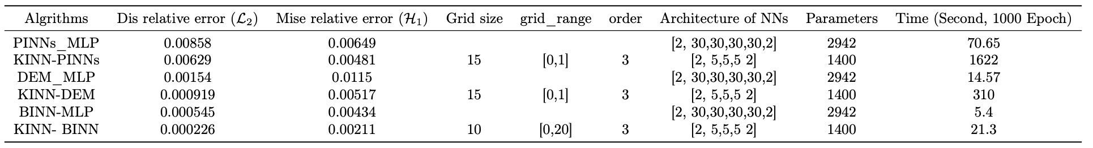
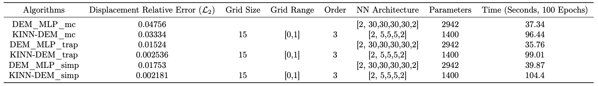
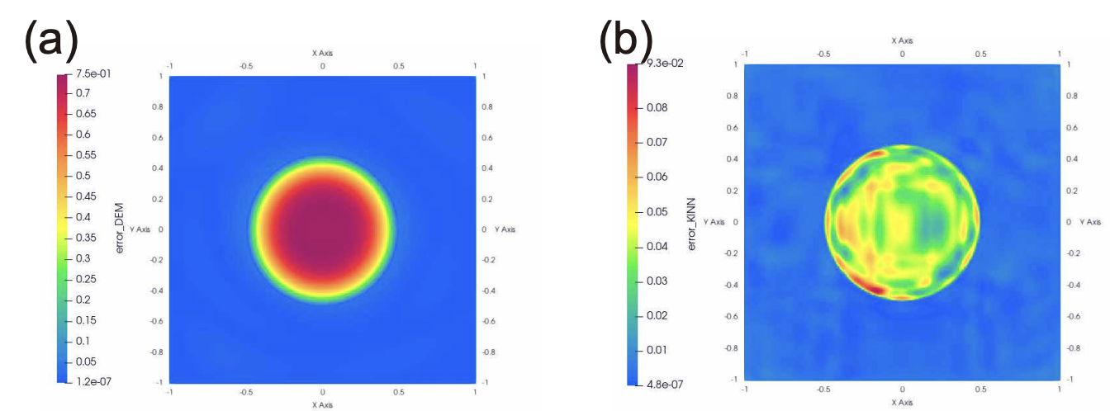
experiment
4. 其他方程结果
应力集中方程
超弹性问题
异质问题
Conclusion: KAN has higher accuracy and convergence
speed than MLP in most PDE problems. However, KAN’s efficiency is currently lower than
MLP under the same epoch due to the lack of specific optimizations for the KAN algorithm.

Slide 15
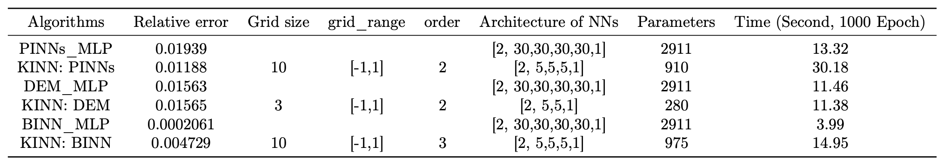
experiment
5. 复杂几何问题
边界条件定义在复杂的几何上
KAN does not perform as well on complex geometric PDE problems, primarily
due to the conflict between grid size and geometric complexity.

Slide 16
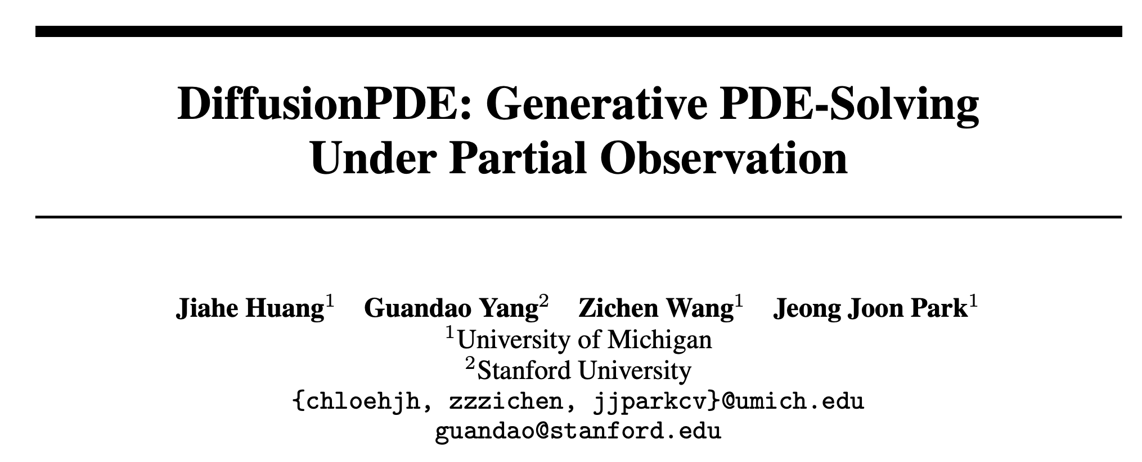

Slide 17
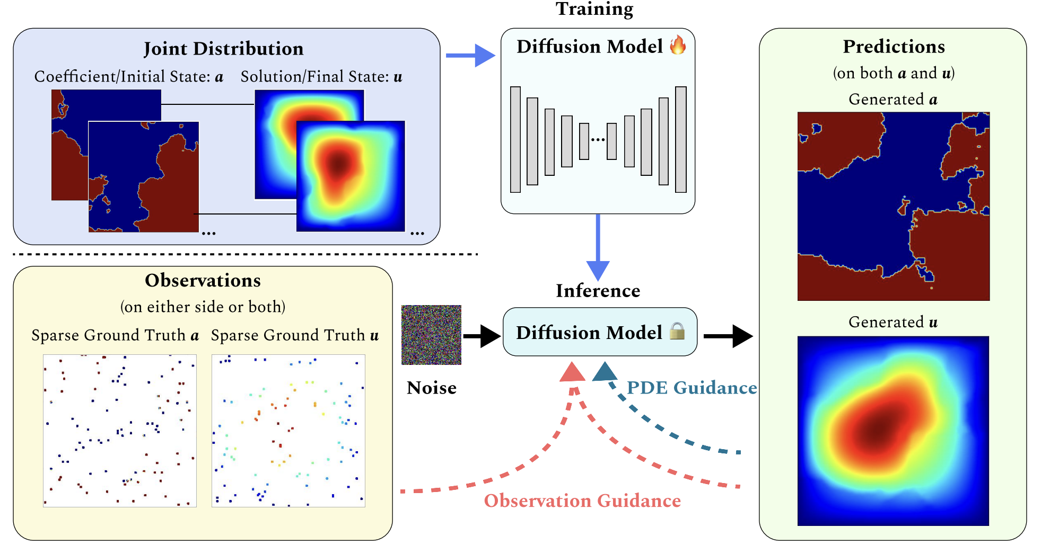
structure
建模解与初始状态(参数状态)的联合分布，解决正反问题

Slide 18
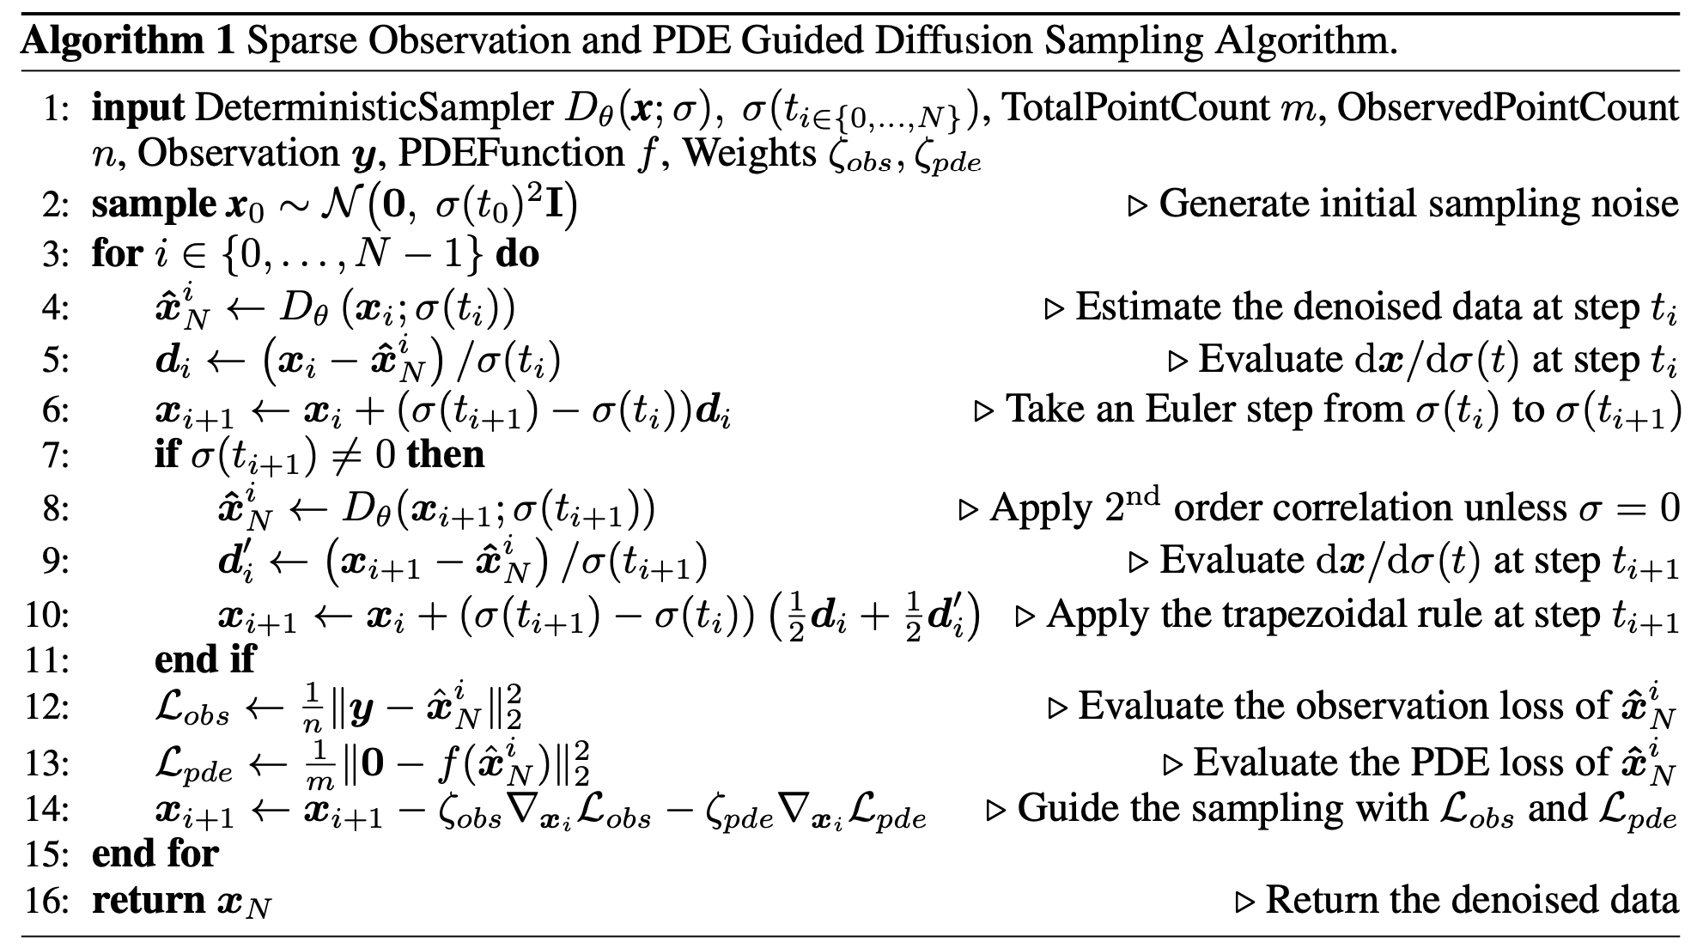
Algorithm
利用DPS（diffusion posterior sampling）扩散后验采样方法将pde和观测点信息加入引导中

Slide 19
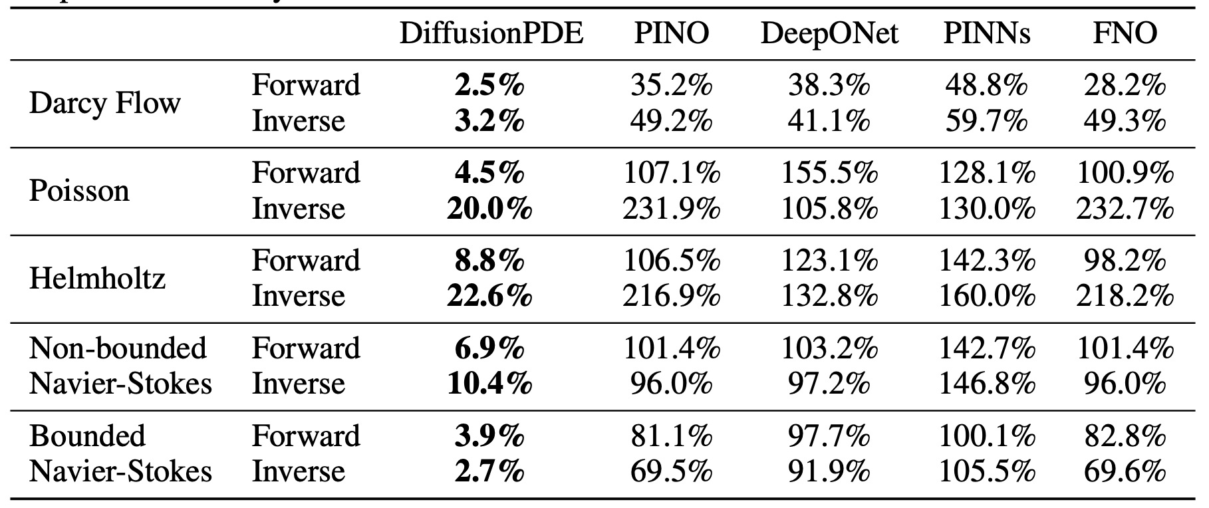
result
conclusion： state-of-the-art；highly partial observations
time waste；slices of 2D dynamic PDEs； struggle with
accuracy in spaces that lack constraints

